Slide 1
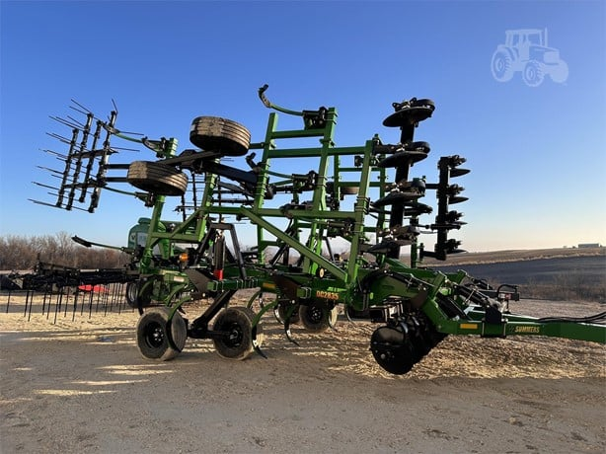
Chisel Plow
Summers DC2835
Used
22 feet wide
$78,500

Slide 2
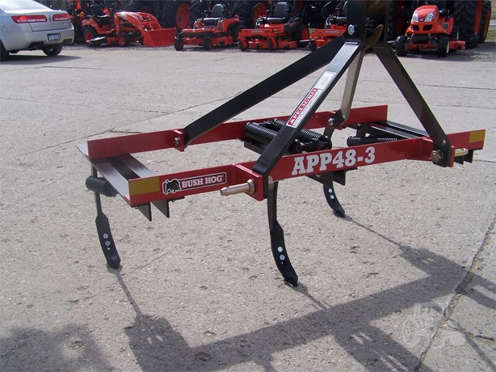
Chisel Plow
Bush Hog APP48-3
New
4 feet wide
$1,025

Slide 3
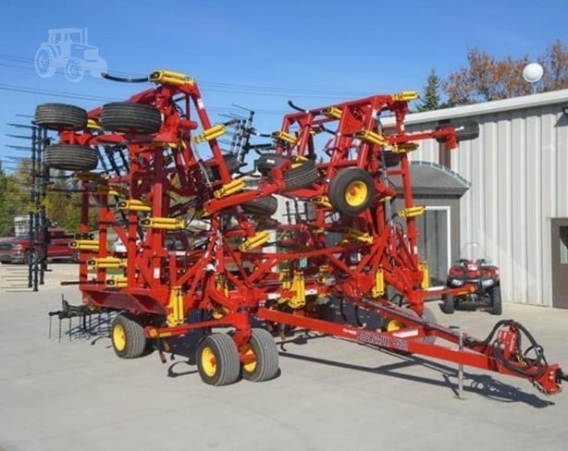
Chisel Plow
Bourgault 9500-60
New
60 feet wide
$146,000

Slide 4
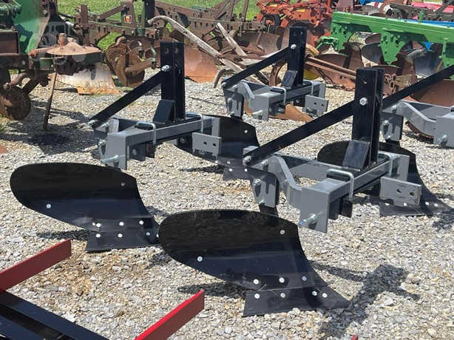
Moldboard Plow
Titan Implement 6114
New
2 bottom plow
14 in plowshare
2.33 feet wide
$850

Slide 5
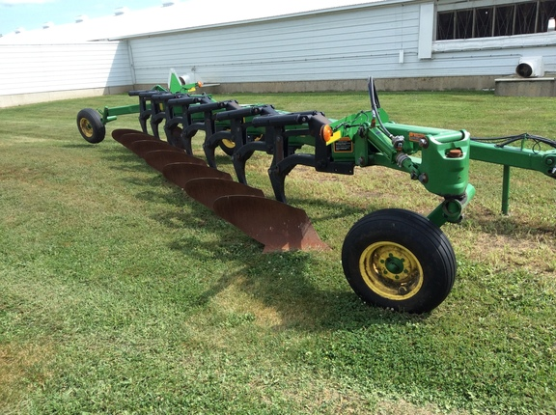
Moldboard Plow
John Deere 3710
Used
7 bottom
12 in plowshare
7 feet wide
$18,000

Slide 6
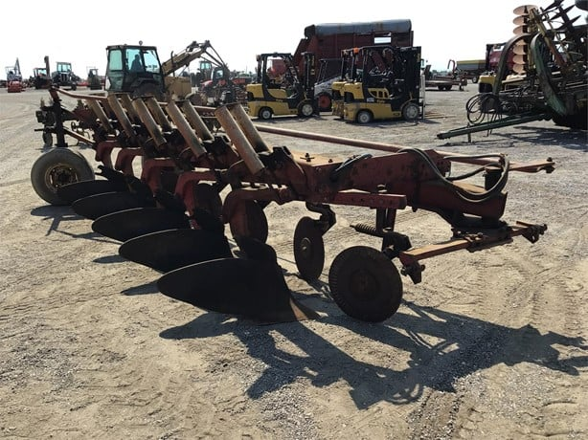
Moldboard Plow
International 720
Used
5 bottom
12 in plowshare
5 feet wide
$5,000

Slide 7
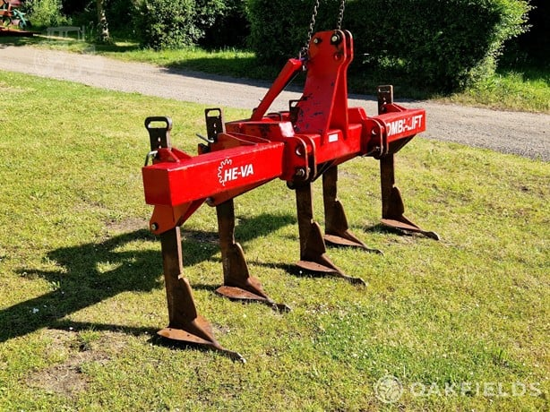
Ripper
International 720
Used
5 shank
30 in spacing
10 feet wide
$3,000

Slide 8
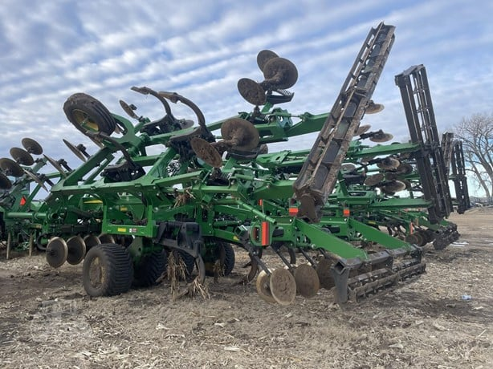
Combination Ripper
John Deere 2730
Used
13 shank
22 feet wide
$140,000

Slide 9
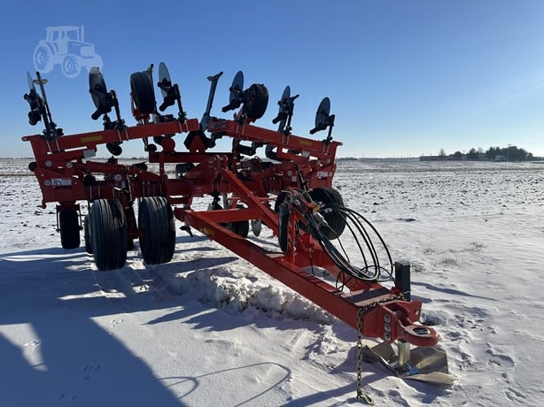
In-Line Ripper
Kuhn Krause 4835-1130F
New
11 shank
15 feet wide
$71,000

Slide 10
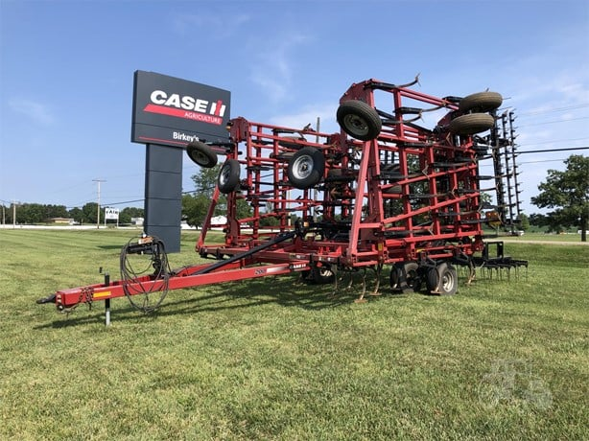
Field Cultivator
CASE IH Tigermate 200
Used
48.5 feet wide
$25,000

Slide 11
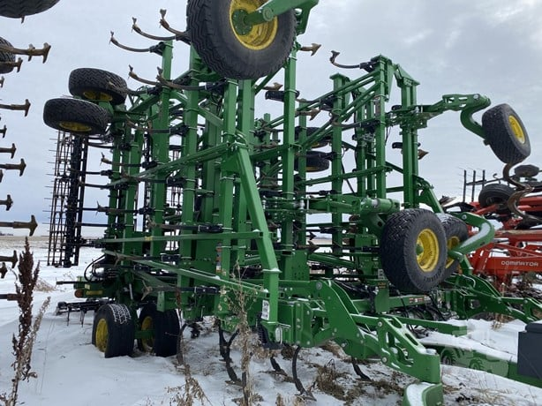
Field Cultivator
John Deere 2230FH
Used
56 feet wide
$165,000

Slide 12
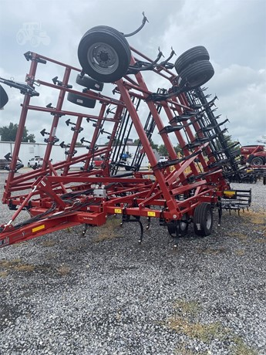
Field Cultivator
CASE IH Tigermate 255
New
35 feet wide
$78,000

Slide 13
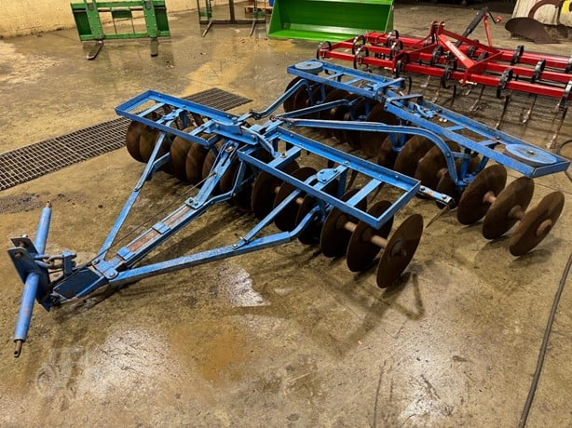
Disk Harrow
Ford 201
Used
8 feet wide
$1,000

Slide 14
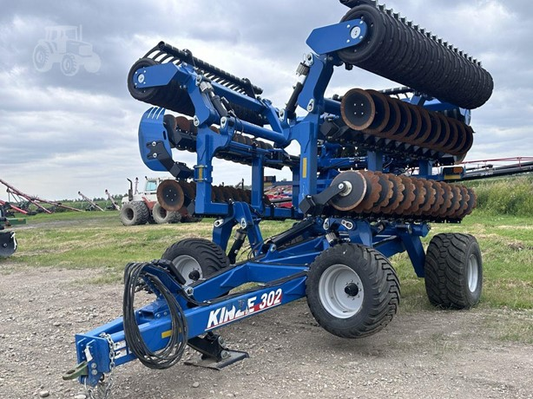
Disk Harrow
Kinze Mach Till
Used
30 feet wide
$134,000

Slide 15
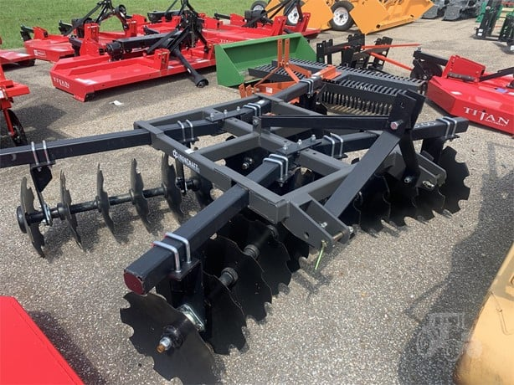
Disk Harrow
Ironcraft 7324
New
7 feet wide
$3,000

Slide 16
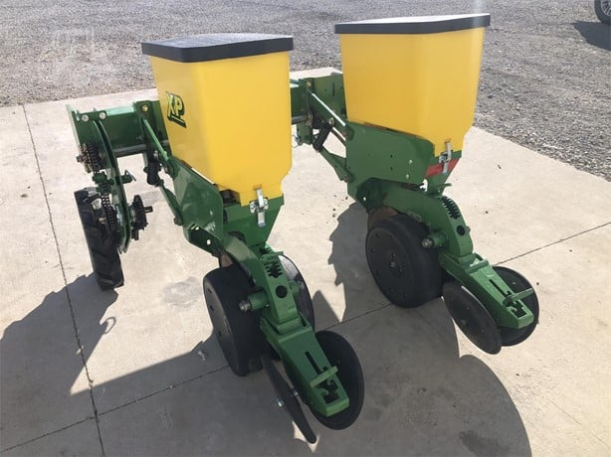
Planter
John Deere 1775NT
Used
2 row
30 in rows
5 Foot width
$5,200

Slide 17
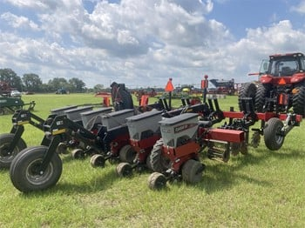
Planter
Case IH 1215
Used
6 row
30 in rows
15 Foot width
$12,000

Slide 18
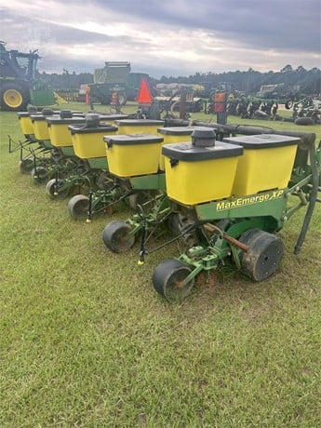
Planter
John Deere 1700
Used
6 row
30 in rows
15 Foot width
$14,500

Slide 19
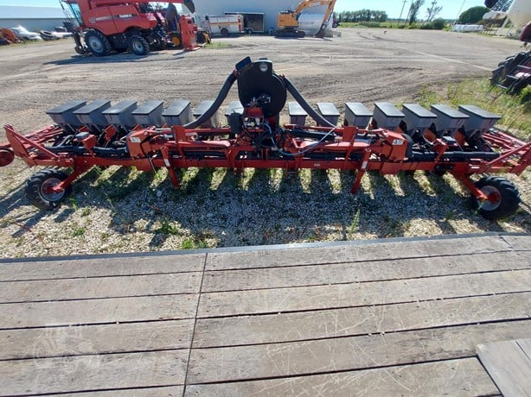
Planter
Case IH 1230
Used
8 row
30 in rows
20 Foot width
$17,500

Slide 20
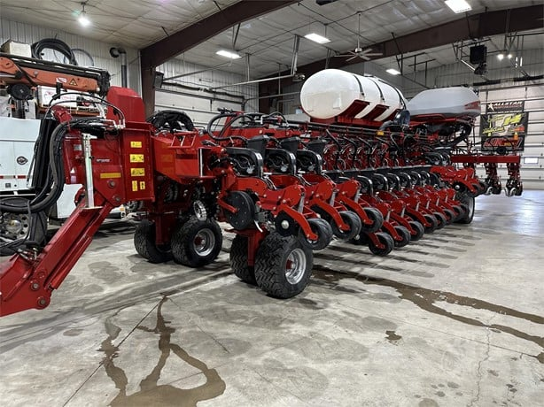
Planter
Case IH 2160
New
36 row
30 in rows
90 Foot width
$543,500

Slide 21
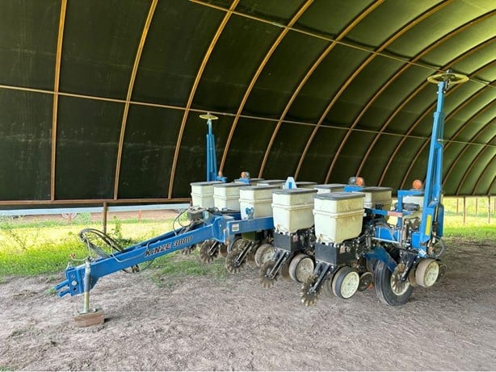
Planter
Kinze 3000
Used
11 row
30 in rows
27.5 Foot width
$40,500

Slide 22
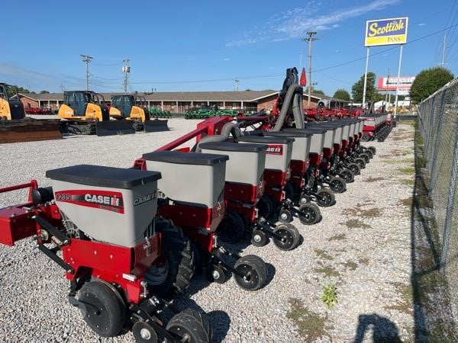
Planter
Case IH 1235
Used
12 row
30 in rows
30 Foot width
$60,500

Slide 23
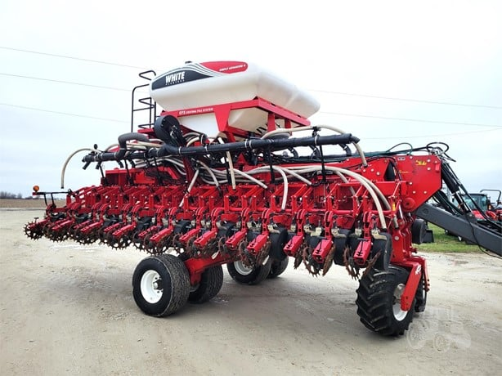
Planter
Massey Ferguson 9831
New
16 row
30 in rows
40 Foot width
$114,000

Slide 24
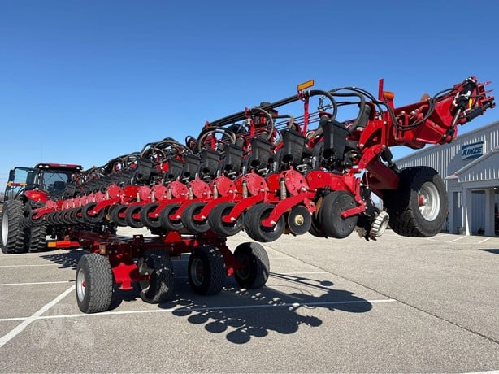
Planter
Case IH 2140
Used
24 row
30 in rows
60 Foot width
$227,000

Slide 25
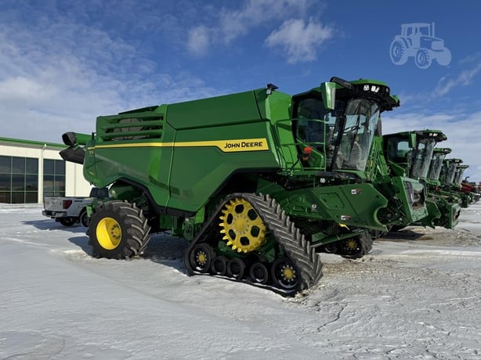
Combine
John Deere X9 1100
Used
Compatible with John deere headers
$955,000

Slide 26
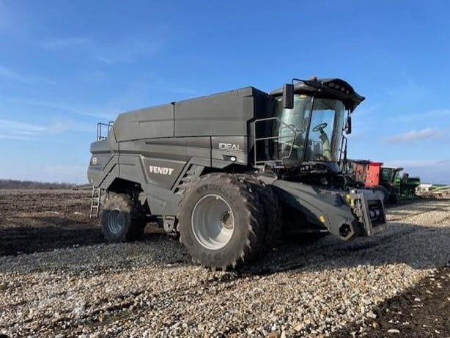
Combine
Fendt Ideal 8
Used
Compatible with Fendt headers
$495,000

Slide 27
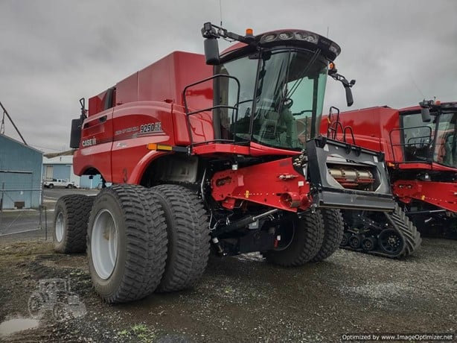
Combine
Case IH 9250
Used
Compatible with Case IH headers
$855,000

Slide 28
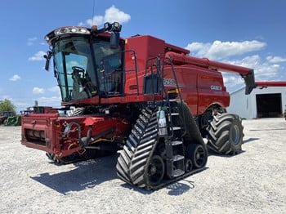
Combine
Case IH 8250
Used
Compatible with Case IH headers
$495,000

Slide 29
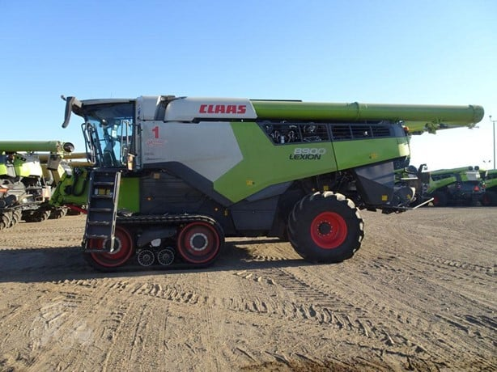
Combine
CLAAS Lexion 8900TT
Used
Compatible with CLAAS headers
$737,000

Slide 30
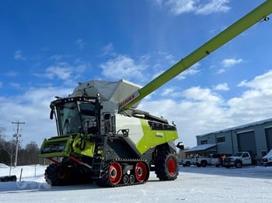
Combine
CLAAS Lexion 8700TT
Used
Compatible with CLAAS headers
$498,000

Slide 31
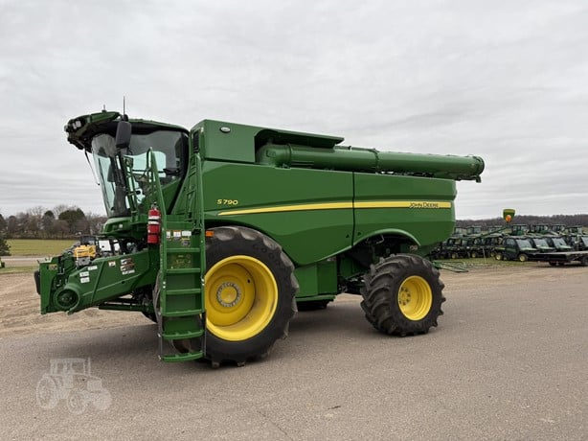
Combine
John Deere S790
Used
Compatible with John Deere headers
$629,000

Slide 32
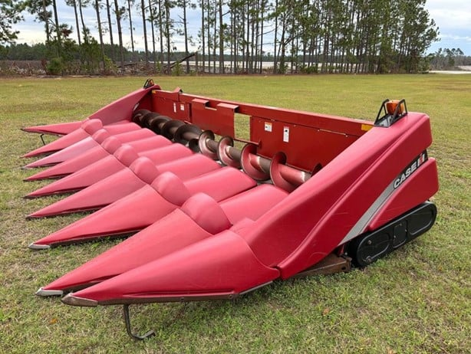
Corn Header
Case IH 3408
Used
8 row
30 in rows
$5,000

Slide 33
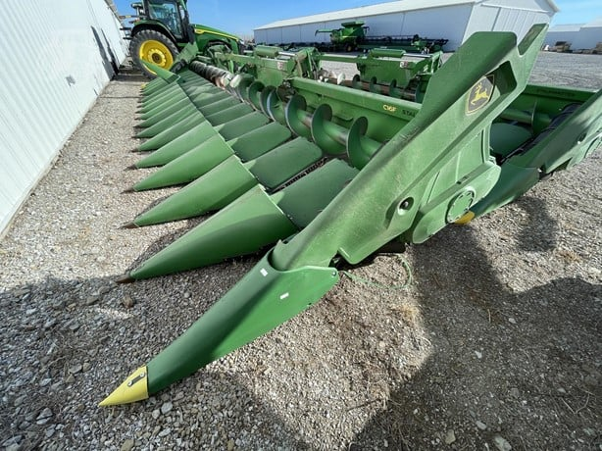
Corn Header
John Deere C16F
Used
16 row
30 in rows
$296,000

Slide 34
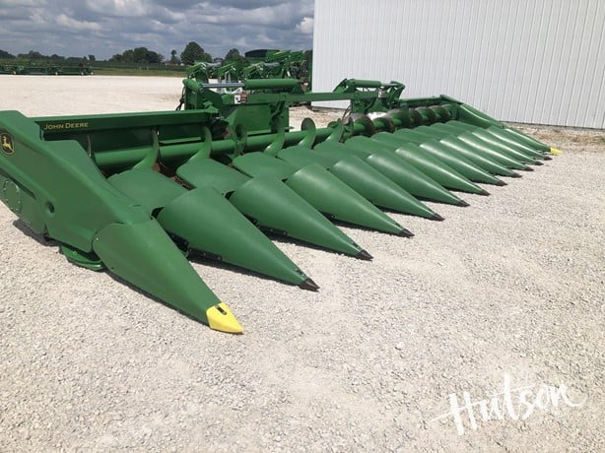
Corn Header
John Deere C12F
Used
12 row
30 in rows
$184,000

Slide 35
Corn Header
Case IH 3408
Used
8 row
30 in rows
$5,000

